Slide 1

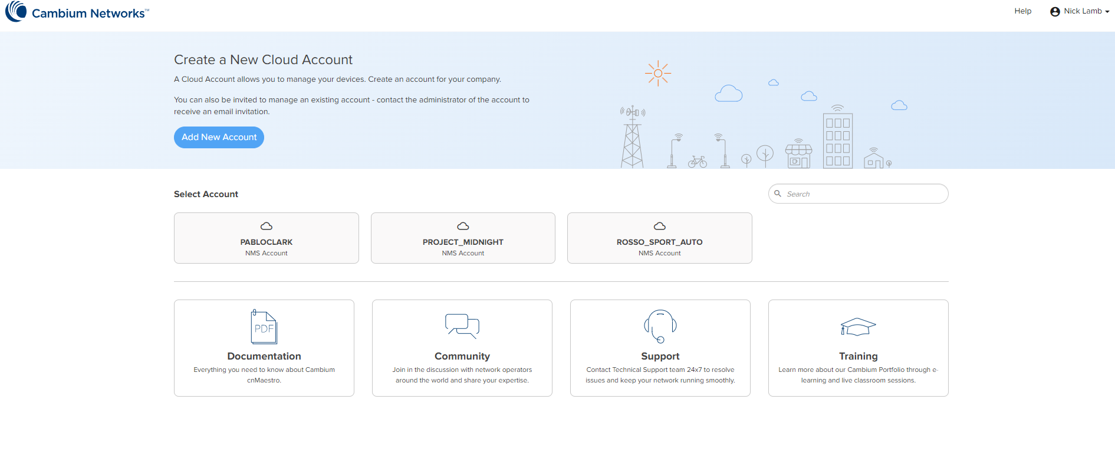



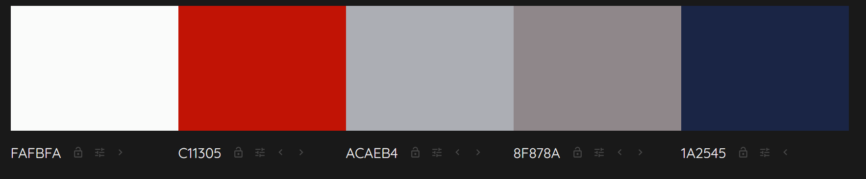
Liminal Clarity AI
Create a new case
A case is to be created per individual to be analysed. A case houses the briefing, data and reported findings of a Liminal Clarity AI investigation.
You can also be invited to collaborate on an existing case. Contact the case administrator to receive an invitation in your account.
New screen
Case number
A unique identifier for this report
Case name
Name of individual
Case description
Description of case
Detailed description of area of concern for context
Whisteblower statement, and/or detailed problem statement
Additional relevant keywords to provide further context
Individual names, entity names, deal names, date range etc
Internal org data
External data
Description
Drag and drop evidence here (MS Office files, PST/OST, Teams data, PDF, CSV)
Browse
Upload
File description, supplier list, employee list etc
[list of uploaded files, updated at each addition]
Edit item
Delete item
I agree to the Liminal Clarity AI terms of service
Process new case
Cancel

Slide 2
Liminal Clarity AI
Create a new case
A case is to be created per individual to be analysed. A case houses the briefing, data and reported findings of an investigation file.
You can also be invited to collaborate on an existing case. Contact the case administrator to receive an invitation in your account.
Case [number], [name] successfully added. Processing to commence.
Case directory
New screen

Slide 3
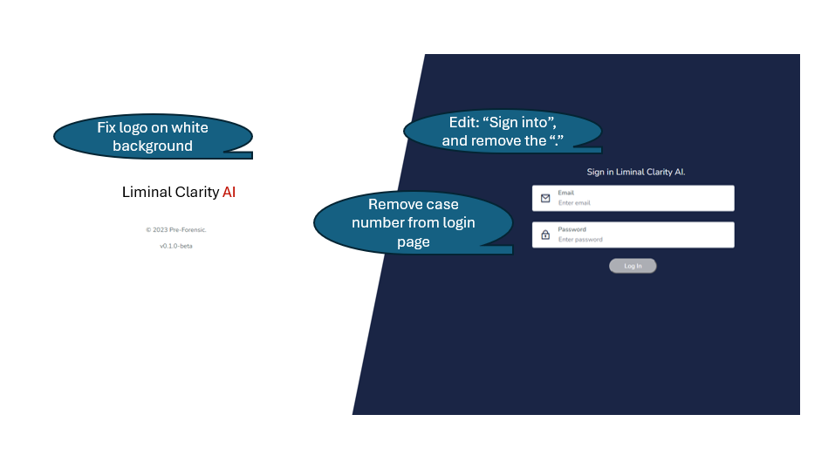
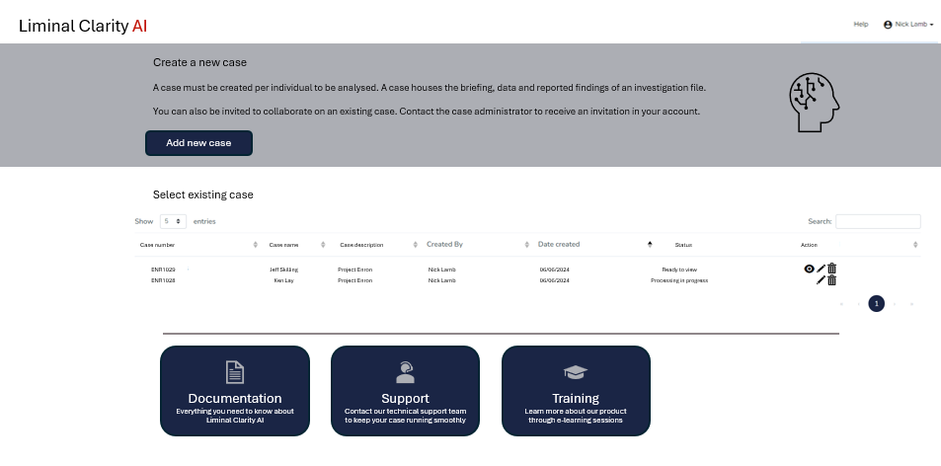
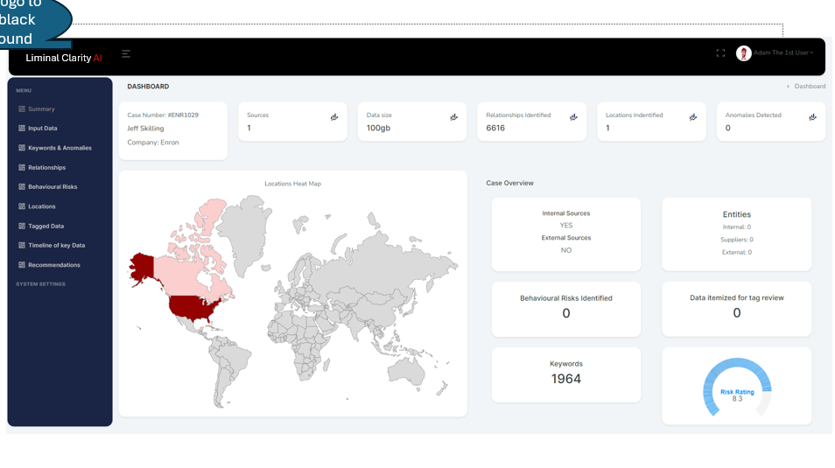
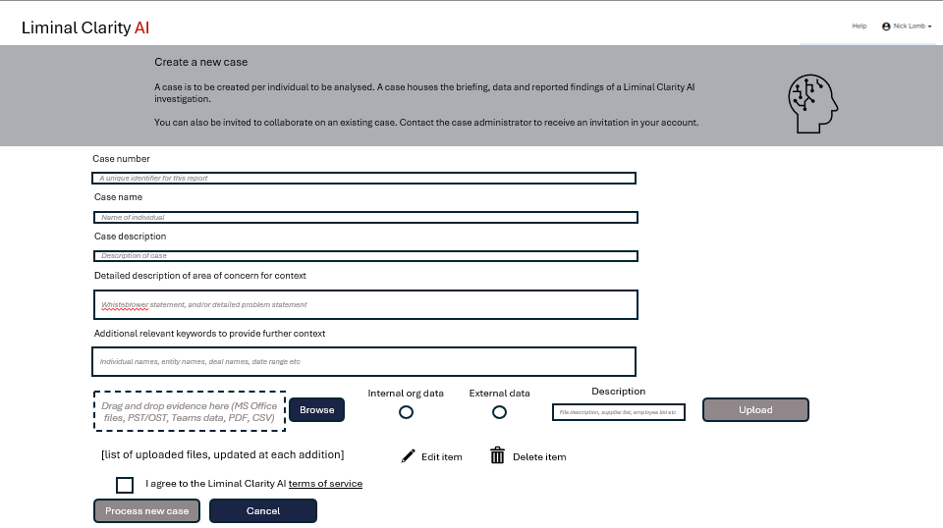
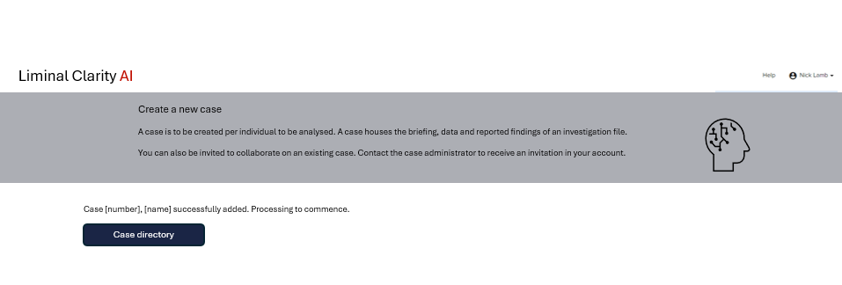
New window
Case management screen flow

